Slide 1



The new hydrogen era: Transition to a green economy
Dr. Dimitrios Psychoyios
Vice President
Regulatory Authority for Energy
Associate Professor of Finance
University of Piraeus
Notes:
The ‘rock star of new energies’
Bill Gates says it’s “a huge deal”.
Frans Timmermans, the EU’s green boss, says “it rocks”.
Shell chief Ben van Beurden says “we cannot aim to be a net-zero economy [without it].”
In the energy world, it has become increasingly difficult to avoid the subject of hydrogen.

Slide 2
Problem Definition
Climate change aggravates and brings about potential risks for both human society and natural systems.
Global warming induces natural disasters and pandemics.
Environmental degradation increases capital market volatility, complicates global trade network, and further influence the functioning of energy markets, leading to recession and unemployment.
Clean energy (mainly solar and wind energy) consumption is considered as an effective way to deal with climate change.
However, wind and solar power alone face a substantial difficulty in becoming economical at high market shares, as such, a deep decarbonisation of power systems will be hard to achieve based on them alone.
Other supplementary low carbon technologies are likely to be needed. Hydrogen?

Slide 3
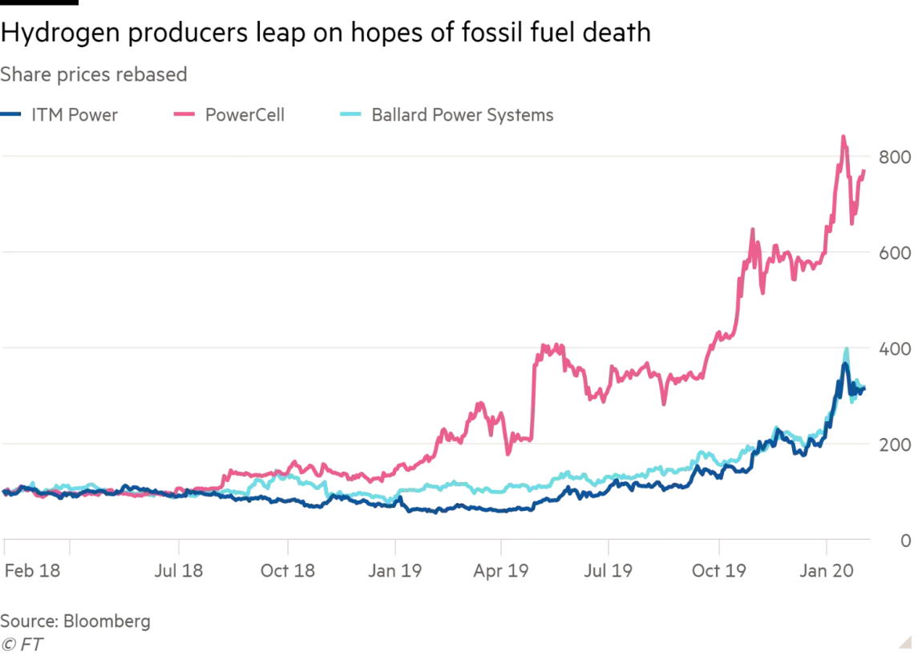
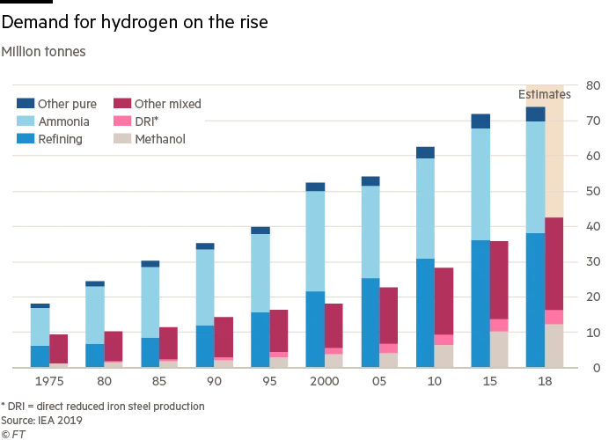
The solution (???)
Hydrogen is a low carbon or carbon-free energy carrier that can be easily stored and transported
It can be used in a variety of sectors, including electric power generation, heating, transportation, and has other industrial uses.
The greater use of the gas could help secure the long-term future of existing (very expensive and undepreciated) infrastructure (oil refineries, pipelines, USFs).
In the long term, hydrogen can offer a complementary solution of flexibility to the power system, particularly in cases with a significant share of renewables in the electricity mix.

Slide 4
Preparing for the future
More than 30 countries have announced hydrogen strategies as part of their path to net zero emissions. EU, Japan and UK wants to become “Hydrogen Superpowers” by 2050.
China subsidises hydrogen fuel cell technology while cutting subsidies for lithium-ion batteries.
The US Department of Energy plans to drastically reduce the cost of renewable or “green” hydrogen by 80% in 10 years. Green hydrogen currently costs $5 per Kg and is inefficient to produce.
With $500bn in global investments expected over the next decade, hydrogen developers think it is the fuel of the future.
Notes:
Despite its attractive characteristics, the development of hydrogen has been obstructed by costs related to 1) co-produced CO2 or solid carbon, 2) input factors of production, and 3) infrastructure related barriers.

Slide 5
European Green Deal
Vision: EU wants to become a pioneer in the use of hydrogen as an energy carrier
The European Commission presented its hydrogen strategy, the aim of which is to make the widespread use of hydrogen possible by 2050.
Priority is to be given to green hydrogen.
The EU hydrogen strategy is designed in three phases:
By 2024, the production of green hydrogen should increase to one million tons per year. (For comparison: at present, almost 10 million tons of hydrogen per year are produced in the EU from and with fossil fuels).
By 2030, the production of green hydrogen should increase to ten million tons per year.
From the period between 2030 and 2050, green hydrogen is to be produced on a systemically relevant scale.

Slide 6
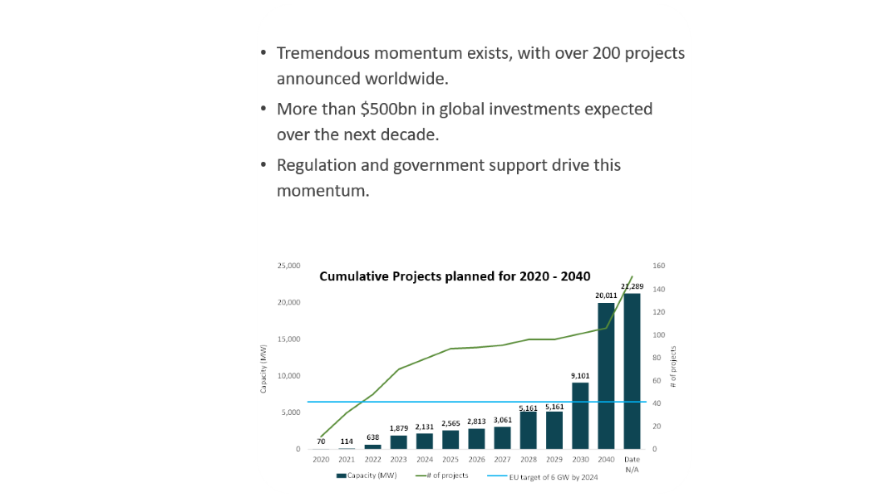
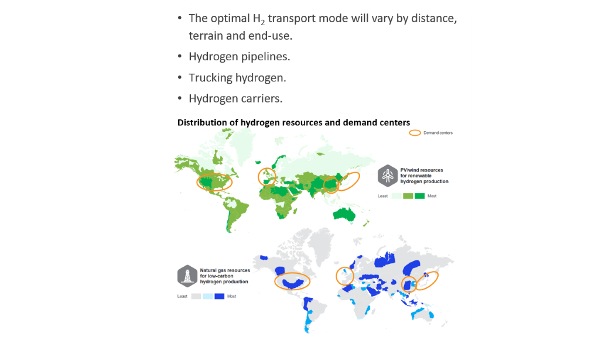
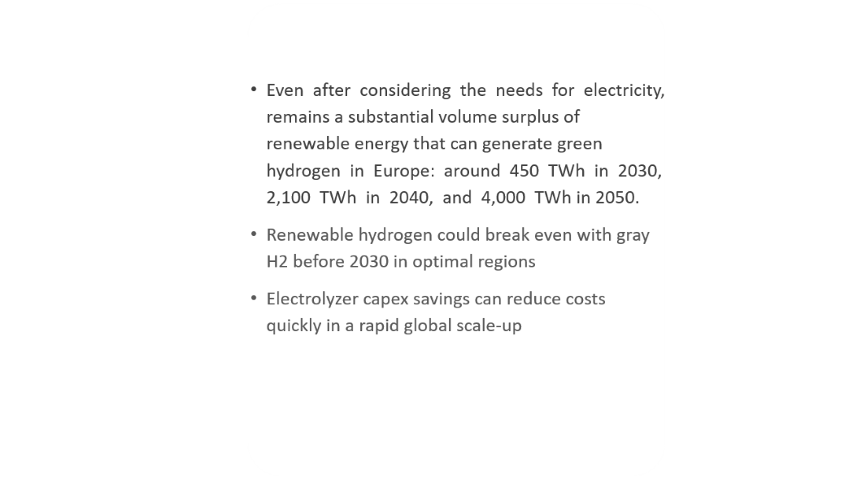
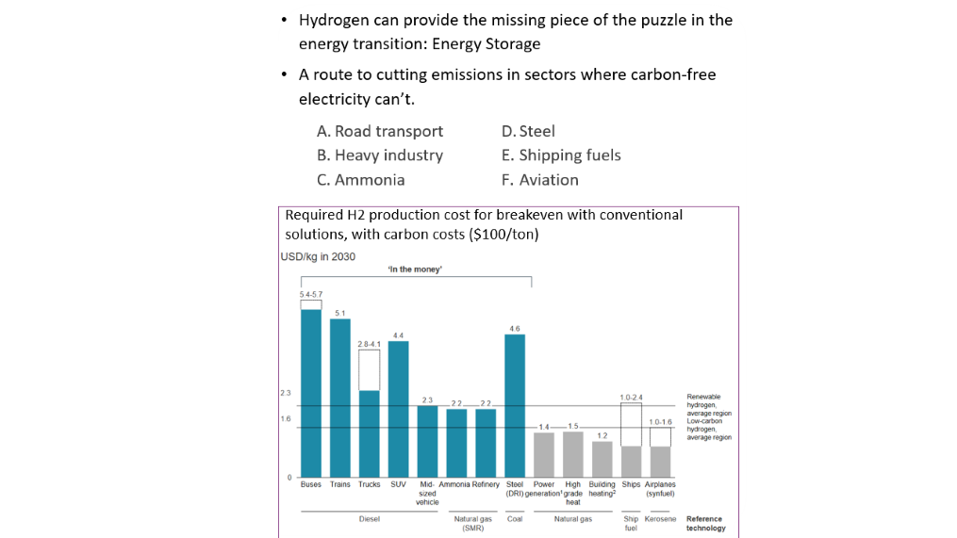
The business model
Deployment & financing
Supply
Distribution/ Supply Chain
Demand/ End applications

Slide 7
The business model
Tremendous momentum exists, with over 200 projects announced worldwide.
More than $500bn in global investments expected over the next decade.
Regulation and government support drive this momentum.
Cumulative Projects planned for 2020 - 2040

Slide 8
The business model
Even after considering the needs for electricity, remains a substantial volume surplus of renewable energy that can generate green hydrogen in Europe: around 450 TWh in 2030, 2,100 TWh in 2040, and 4,000 TWh in 2050.
Renewable hydrogen could break even with gray H2 before 2030 in optimal regions
Electrolyzer capex savings can reduce costs quickly in a rapid global scale-up

Slide 9
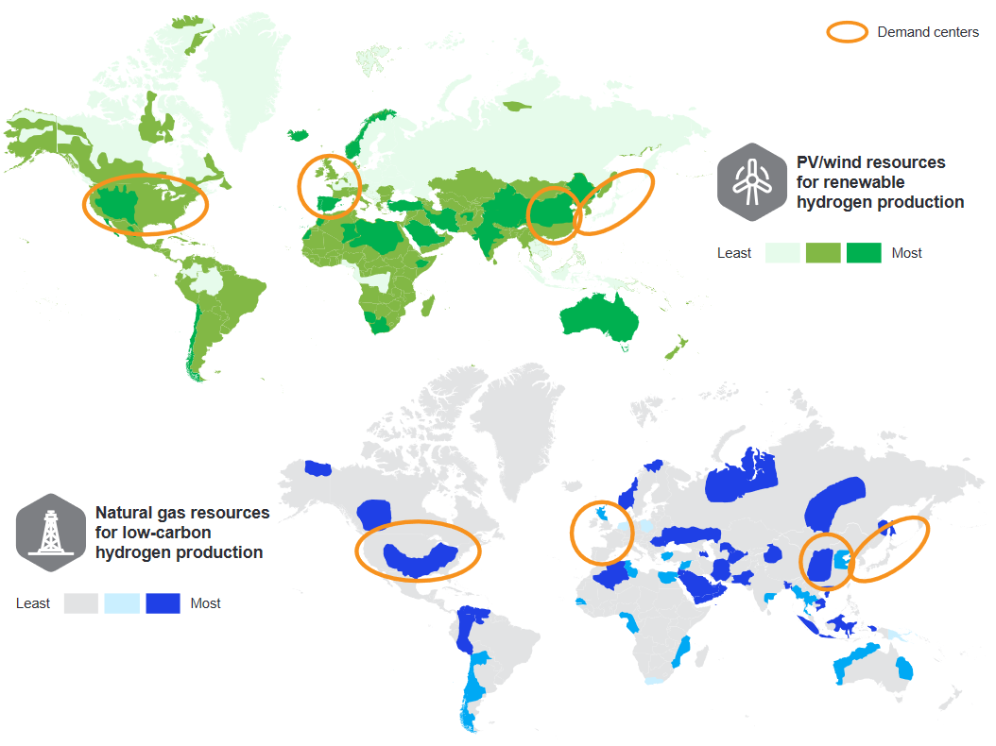
The business model
The optimal H₂ transport mode will vary by distance, terrain and end-use.
Hydrogen pipelines.
Τrucking hydrogen.
Hydrogen carriers.
Distribution of hydrogen resources and demand centers

Slide 10
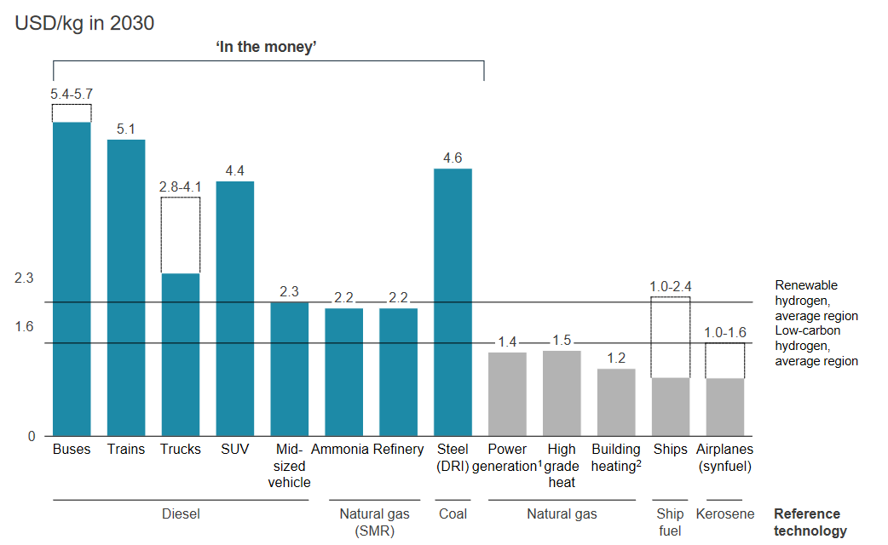
The business model
Hydrogen can provide the missing piece of the puzzle in the energy transition: Energy Storage
A route to cutting emissions in sectors where carbon-free electricity can’t.
  Road transport
  Heavy industry
  Ammonia
  Steel
  Shipping fuels
  Aviation
Required H2 production cost for breakeven with conventional solutions, with carbon costs ($100/ton)

Slide 11

Chalenges
Rating agency representatives outlined the difficulty of evaluating green hydrogen projects.
Investors have to invest (bet?) on a technology that remains in its infancy. Most hydrogen is produced from fossil fuels, creating millions of tonnes of carbon dioxide.
Taxpayers must pay vast amounts for new infrastructures or provide incentives to the private sector to do it.
Others argue that producing green hydrogen via electrolysis is an extremely inefficient way of using renewable electricity. There is an immediate energy loss, to break the chemical bond between oxygen and hydrogen, of 30 per cent and there are further inefficiencies depending on how it is then deployed.
Hydrogen is very expensive (even if the DoE achieves its goal price of $1 per Kg in the next 10 years, hydrogen would still be three times more expensive than US natural gas).
Notes:
But green hydrogen faces several challenges before it can be adopted for large-scale use.
“You won’t see any hydrogen usage in cars,” said Volkswagen chief executive Herbert Diess.
For most of the suggested uses of the green electricity-based hydrogen [at least] around half of the energy in the green electricity is lost. Green electricity is a commodity [that will be] in short supply within Europe for many years to come . . . it doesn’t make sense from a climate policy point of view to waste half, or more, of the green electricity for producing hydrogen

Slide 12
My opinion
We cannot expect everything to be green and sustainable and our individual behaviours and lives remain the same.
We cannot achieve the targets for limiting the global rise in temperatures set out by the Paris agreement without low carbon hydrogen.
Beyond 2030 hydrogen’s future is still uncertain. It is unlikely that hydrogen will be able to operate without support for many years.
Ultimately it will come down to what policymakers and business leaders decide, regardless of whether it is produced via power-to-gas technology or paired with carbon capture and storage.
Regulation must focus on addressing the pressure points of hydrogen technology to bring down costs. Targets alone cannot deliver this.
Hydrogen is presented as a very easy solution to an enormously complex problem. But just because it’s simple doesn’t mean it’s the wrong answer. For now it is the best answer we have.
Notes:
Countries will continue to struggle choosing the preferred technology facing the expensive or dependent supply of natural gas, difficulties in infrastructure expansion or modification, and coordination across countries. As such, the decisions regarding “green” hydrogen can be explained by the disadvantages of the alternative, rather than the attractiveness of the “green” technology.

