Slide 1
Company profile 2021
Company profile 2021

Slide 2
Introduction
We believe climate change to be the number one threat to civilization ; hence all our efforts should be directed towards facing this challenge now.
We further believe that the single most determinant answer to this lies in the immediate and extensive deployment of all Renewable sources, until we establish a 100% Renewables energy mix and a zero carbon economy.
Company profile 2021

Slide 3
Introduction
General Manager R.E.D. Pro Consultants Renewable Energy Development Professionals
Director REDPRO Climate & Energy Consultants (Kenya)
Visiting Professor at Technical University of Mombasa (TUM)
Director of RECCReC, the Renewable Energy & Climate Change Research Center at TUM
Lead Country Contributor for Greece REN21
Elected Member of Greenpeace Greece Electoral Body
Senior advisor at EPU/NTUA H2020/PARIS REINFORCE
Senior Expert at EPU/NTUA for EU GCC Clean Energy Technology Network
Editor e-mc2 (Energy Matters to Climate Change)
Chairman of NGO A.F.R.I.C.A.
Mentor at I.S.N.A.D. Africa
f. CEO of P.P.C.R. / f. Chairman & CEO of H.W.E.A.
Dr. Ioannis Tsipouridis
Renewable Energy Consultant Engineer -with over 40 years of studies and experience in the field of renewable energy
Company profile 2021

Slide 4
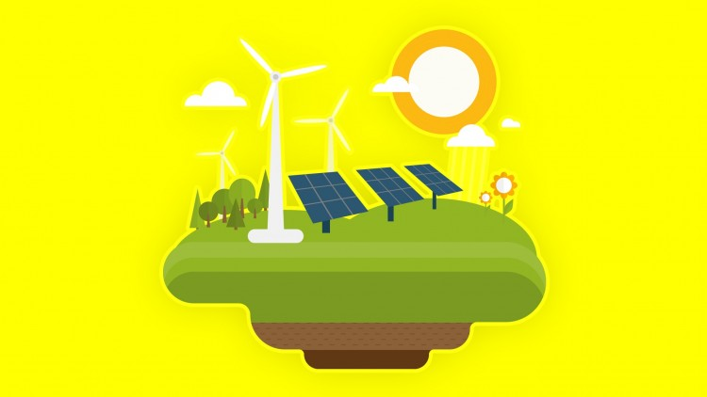
About REDPro
REDPro is a renewable energy consultancy firm based in Athens, providing specialist expertise and consultancy services for
utility and community scale sustainable energy projects
climate change mitigation and adaptation solutions and
green growth development practices
targeting the empowerment of communities, women and youth, through interventions in the Energy-Water-Health nexus, pursuant to the attainment of the 2030 sustainable development goals.
Company profile 2021

Slide 5
What we do
RES investment Consultancy
RES projects licensing
Brokerage and due diligence
Net metering
Small wind turbines
We provide consultancy services to any interested entity wishing to invest in the development of renewable energy sources in Greece and abroad.
We undertake project licensing procedures on any level requested, by anyone beginning the adventurous and self rewarding trip into Renewables development.
We provide brokerage and due diligence consultancy services to anyone wishing to acquire renewable energy sources projects in Greece.
We undertake licensing, procurement and installation for net metering applications.
We undertake licensing, procurement and installation for small wind turbines projects.
Company profile 2021

Slide 6
What we do
Renewables & Climate change
Floating offshore wind
Renewable market studies in East Mediterranean & Africa
E-mc²: Energy Matters to climate change
SynaptiQ Software for RESmanagement
We actively participate in the climate change and renewables development dialogue and programmes in European and East Mediterranean level.
We actively participate in the dialogue and programmes for floating offshore development in the East Mediterranean and East Africa.
We undertake renewable market studies in the East Mediterranean , Middle East and Sub Saharan African regions.
We promote knowledge and dissemination of news and scientific truth and facts regarding renewables and climate change through our climate and energy portal e-mc².
In cooperation with Belgium-based 3E, we provide software for your Wind and Solar assets.
Company profile 2021

Slide 7
Our Experience
Market & Energy Analysis
Design of Renewable Energy projects
Contract preparations & negotiations
Equipment and BoP
Procurement
Project Implementation
Siting of Renewable energy projects
Resource regime measurement campaigns
Operation & Maintenance
Financial analysis & appraisal
Company profile 2021

Slide 8
SynaptiQ
Thanks to current data mining techniques, asset operators can easily take decisions on the most effective way of performing their daily operations and maintenance activities, improving the performances of their portfolios and anticipating failures on the devices composing these complex systems.
Company profile 2021

Slide 9
SynaptiQ
Monitoring and performance improvements platforms such as 3E’s SynaptiQ are capable of combining independent monitoring and data collection to the most reliable performance analysis algorithms in the PV industry.
We also offer resource and production forecasting services, essential to any asset manager participating in electricity market.
Company profile 2021

Slide 10
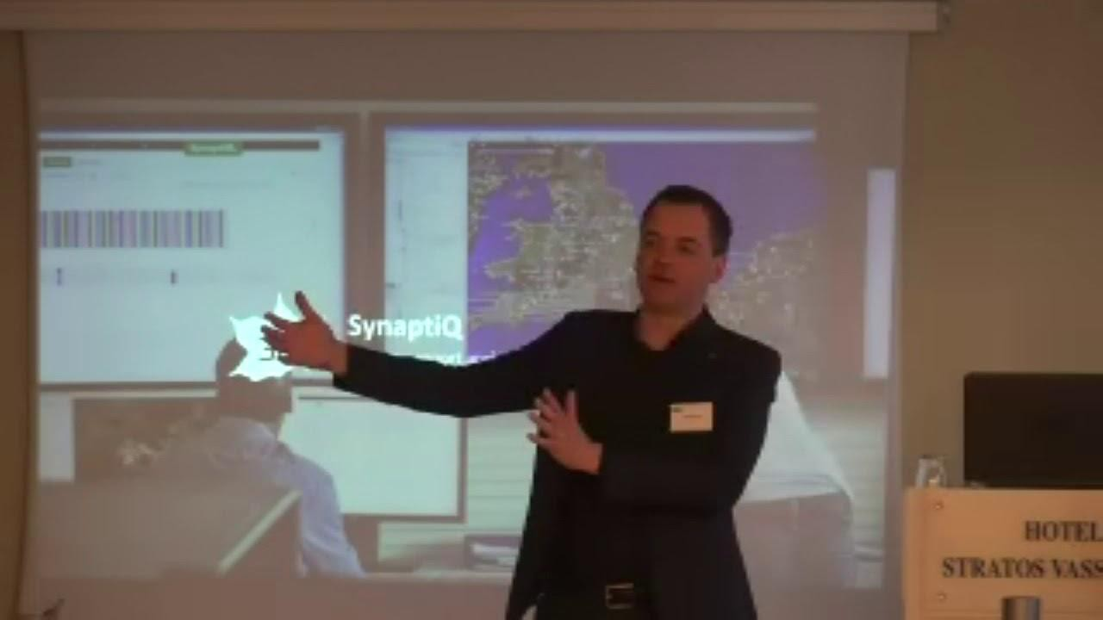
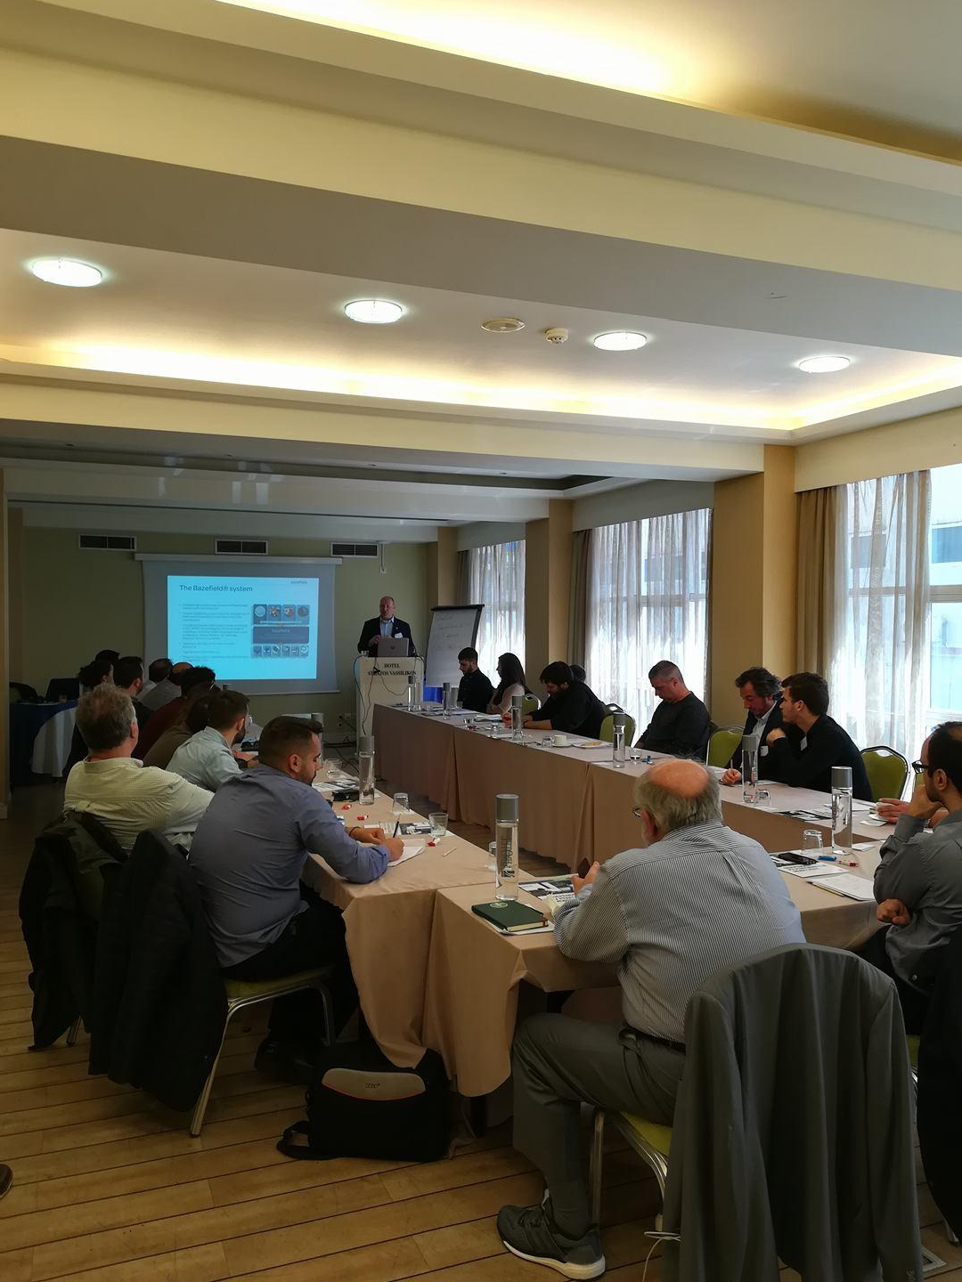
SynaptiQ
On the initiative of REDPro & in collaboration with 3E, we are organizing workshops, well designed for industry professionals who wish to be informed on wind and solar power management software. We are offering useful insights, with real-world examples, where experts from 3E answer your questions.
Company profile 2021

Slide 11
Emc2
E-mc2 covers all aspects of the energy transition revolution in the climate change era, operating on two complementary levels: news reporting and scientific documentation, in two platforms, English & Greek.
On the news front, e-mc2 covers the game changing development in the international as well as the Greek scene, with daily news reports from leading news and scientific sources on climate change. On a daily basis e-mc2 reports the major scientific, financial, political and business news that are targeted to tackle climate change, the greatest threat facing humanity.
Company profile 2021

Slide 12
Emc2
Scientifically, e-mc2 has already created a rich data library available to every citizen, journalist, university student, school student, etc. There one can access valid scientifically documented material for education or information purposes, on issues such as clean energy technologies, climate science, international and national policies, programs, research, energy and climate legislation.
Raising public and stakeholder’s awareness to the imperative need for immediate concrete climate action, in accordance with the COP23 motto “Faster, Further, Together”, in the effort to achieve the mandate set out by UNFCCC’s 1.5oC Special Report.
Company profile 2021

Slide 13
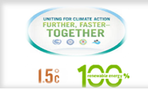
Emc2
We have to #FacetheClimateEmergency and as there is #NoTimetoWaste we demand #ClimateActionNow expecting to see asap the #EndFossilfuelsNow bearing in mind that we also #FightClimateInjustice because to #BuildBackBetter has to have meaning for all and not the same elitist few.
Company profile 2021

Slide 14
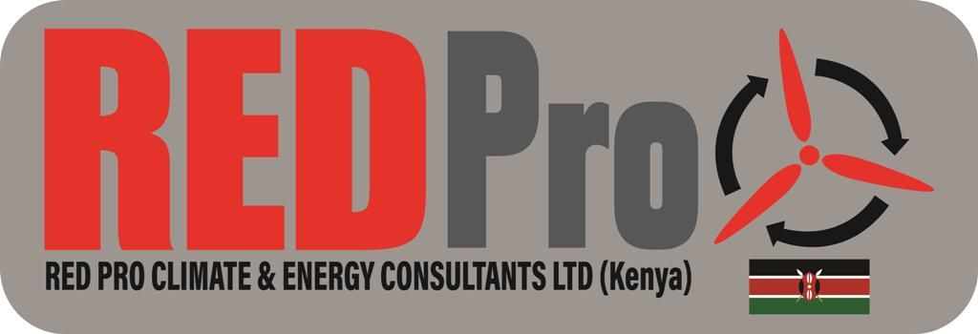
REDPro & Africa
REDPro is proud to have established its subsidiary in Kenya, with a view to expand its activities in Sub-Saharan Africa where energy poverty reigns supreme.
Company profile 2021

Slide 15
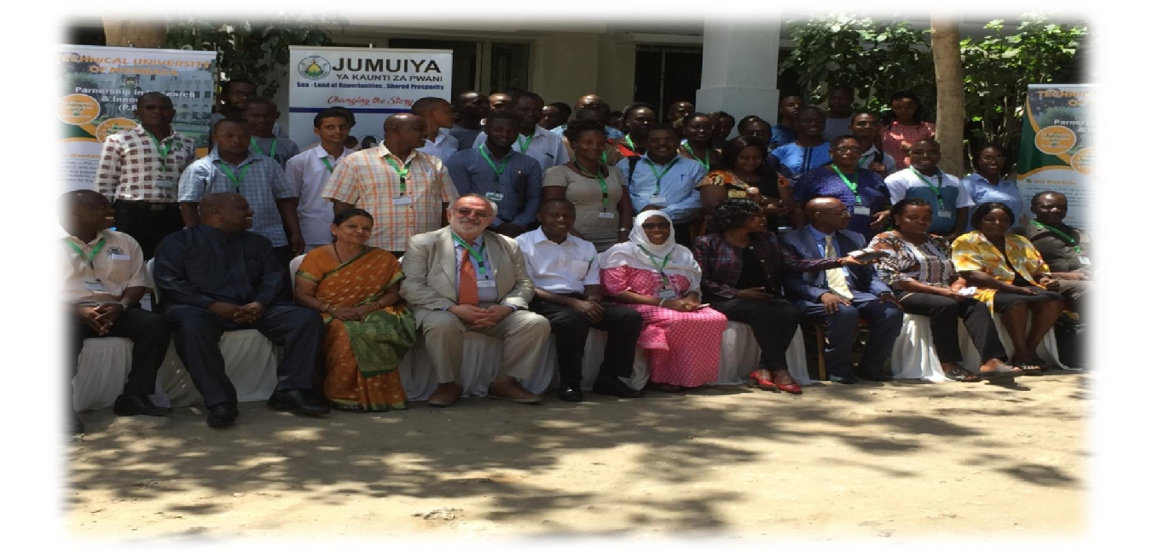
REDPro & Africa
It is Member of the Kenyan Chamber of Commerce in Greece and has already a strong cooperation with the Technical University of Mombasa where Dr. Ioannis Tsipouridis is a Visiting Professor.
Company profile 2021

Slide 16
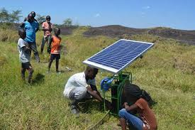
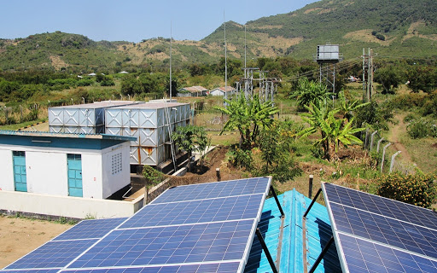
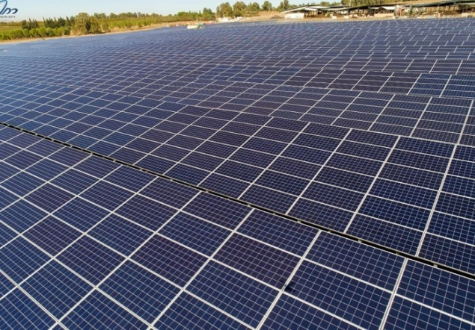
REDPro & Africa
Our current pipeline of projects under investigation, licensing and development consists exclusively of Renewable Energy Sources projects, ranging from large scale wind, solar, biomass and geothermal projects to mini grids, scalable standalone systems and off grid solar systems, powered by inexhaustible renewable energy sources and targeted for rural areas in Africa
Company profile 2021

Slide 17
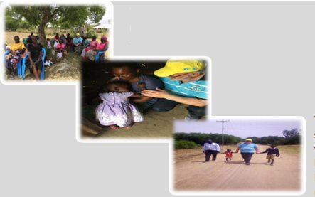
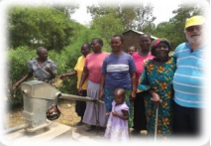
REDPro & Africa
We aim to assist small isolated communities to eradicate energy poverty by means of exploring the continent’s untapped huge clean energy potential in order to provide clean, cheap electricity to small isolated communities, currently having no access to energy and resorting to dirty inefficient fuels causing serious health problems to mothers and young offspring.
We are also working on setting up a training facility in order to promote both capacity building in the fields of renewable energy and climate change adaptation and intercultural understanding.
In collaboration with the Technical University of Mombasa we aim to disseminate knowledge on the use of renewable energy sources to empower communities, through a series of webinars and seminars aimed at all possible stakeholders, from regional government to rural isolated village or slump level.
We plan initially to attract funding to carry out a number of projects showcasing renewables applications, in order to highlight the pathway for the necessary flow of funds to Sub Saharan Africa.
Company profile 2021

Slide 18
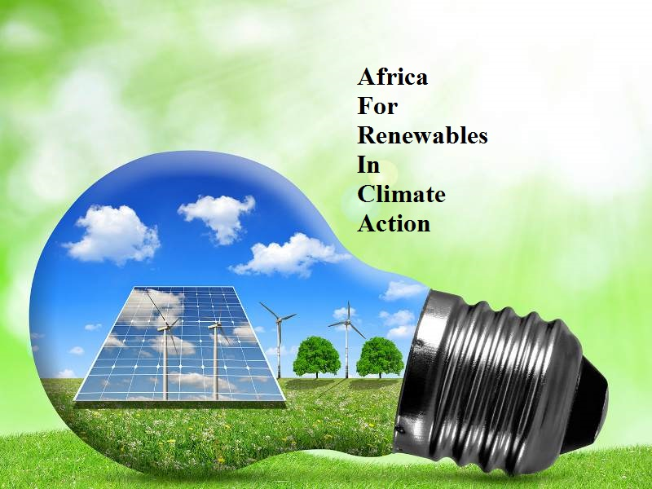
REDPro & Africa
To facilitate its renewables and climate action agenda for African communities, REDPro created and registered in Nairobi,), a nonprofit NGO, A.F.R.I.C.A (AfricaForRenewablesInClimateAction)dedicated to Concrete Global Climate Action, now, to halt & reverse the climate crisis, employing 100% Renewables to eradicate energy poverty, meet SDG7 and empower Africa, as it’s tweeter account (@for_renewables) proudly reads.
A.F.R.I.C.A
A.F.R.I.C.A’s Executive Director Ms Kathleen Mureithi, a Kenyan citizen, who is a researcher by profession with a specific focus on evidence based strategy formulations and executions and a knack for a blend of both leadership and entrepreneurship, is entrusted with this visionary task.
Company profile 2021

Slide 19
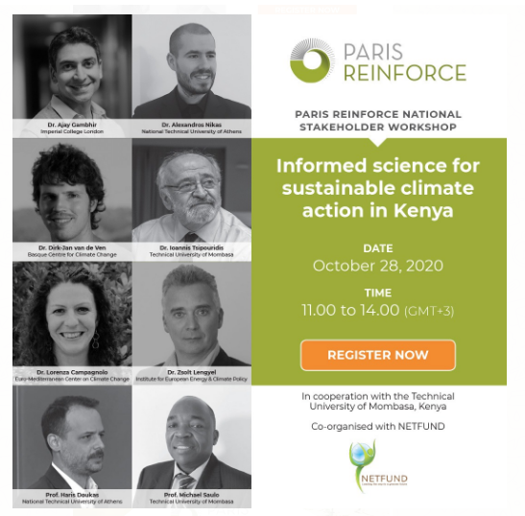
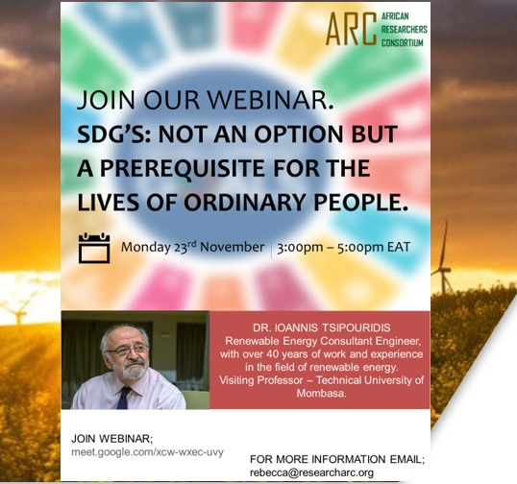
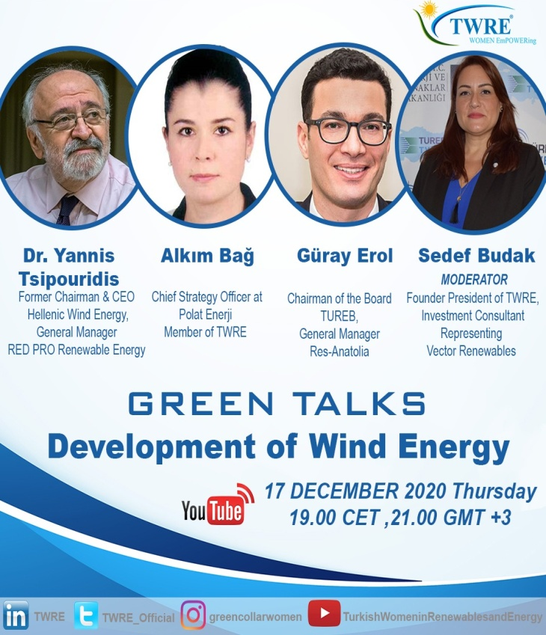
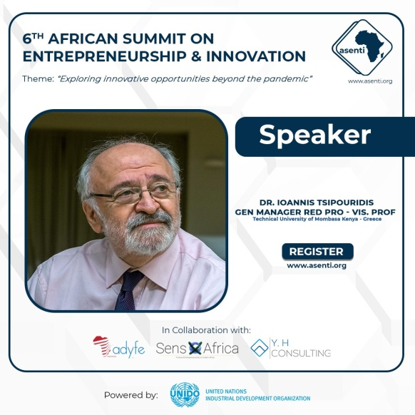
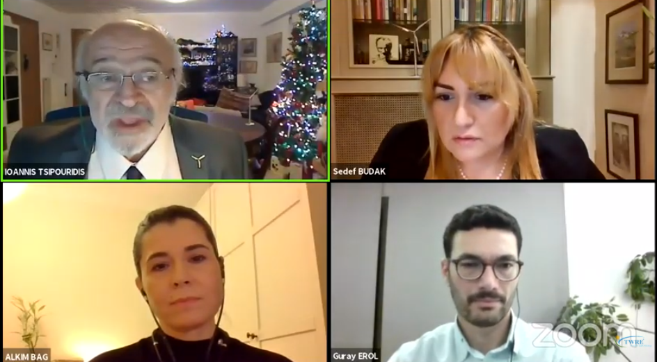
Webinars
Webinars during 2020 & 2021 with the participation of Dr Ioannis Tsipouridis
Company profile 2021

Slide 20
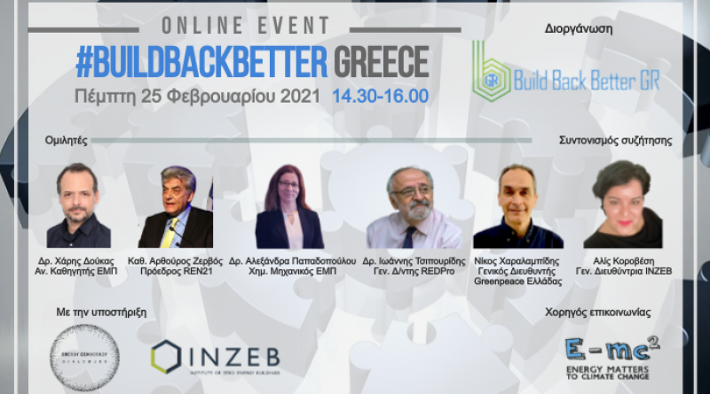
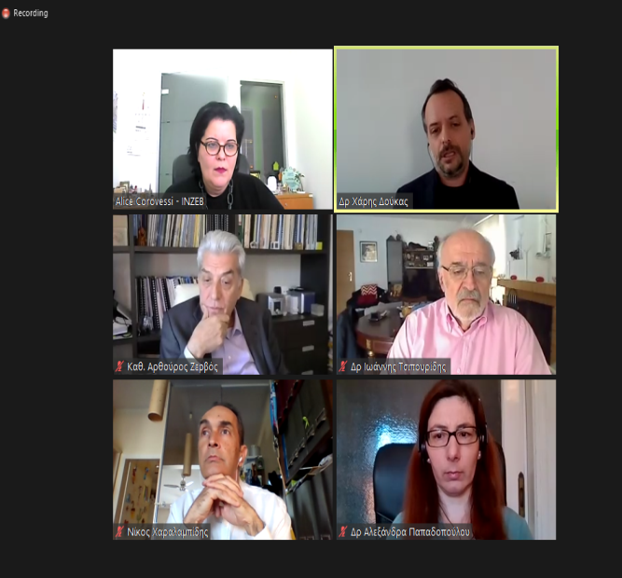
Webinars
Webinars during 2020 & 2021 with the participation of Dr Ioannis Tsipouridis
Company profile 2021

Slide 21
Contact us
EMC2
306 Kifisias Av., 1st Chalandri (Sidera)
Athens 152 32
Tel.: (0030) 213 041 25 33
Website: www.e-mc2.gr/en
Email:emc2.portal.info@gmail.com
REDPro
306 Kifisias Av., 1st Chalandri (Sidera)
Athens 152 32
Tel.: (0030) 213 041 25 33
Website: www.redpro.gr
Email: info@redpro.gr
A.F.R.I.C.A
Social media: https://twitter.com/for_renewables
Email: africaforen@gmail.com
RED PRO CLIMATE & ENERGY CONSULTANTS LIMITED (KENYA)
Giriama road
Mombasa 90420
Kenya
Tel.: +254795519520
Website: www.redpro.gr
Email:
Company profile 2021

