Slide 1

Legal and Regulatory Developments
on Energy Storage
Assoc. Prof. Athanassios S. DAGOUMAS
President
Regulatory Authority for Energy, Greece
Dr George LOIZOS
Head of Electricity Networks and New Technologies
Regulatory Authority for Energy, Greece

Slide 2
Contents
1. Transposition of the Electricity Directive (EU) 2019/944 to the Greek Law
  Definitions
  Ownership of Electricity Storage Facilities
2. New Electricity Storage Licensing Procedure
3. Connection to the Grid Priority
4. Requirements for Grid and Demand Connection
5. System Operation Requirements
6. Funding Initiatives

Slide 3
1
Transposition of the Electricity Directive (EU) 2019/944 to the Greek Law 4951/2022

Slide 4
Definitions for Storage in the “Electricity Directive”
Directive (EU) 2019/944
‘energy storage’ means, in the electricity system, deferring the final use of electricity to a moment later than when it was generated, or the conversion of electrical energy into a form of energy which can be stored, the storing of such energy, and the subsequent reconversion of such energy into electrical energy or use as another energy carrier;
‘energy storage facility’ means, in the electricity system, a facility where energy storage occurs.
‘fully integrated network components’ means network components that are integrated in the transmission or distribution system, including storage facilities, and that are used for the sole purpose of ensuring a secure and reliable operation of the transmission or distribution system, and not for balancing or congestion management;

Slide 5
Definitions for Storage in the Greek Law 4951/2022
(unofficial translation)
Definitions for
Electricity storage: the postponement of the final use of electricity at a time subsequent to its production, with converting it into a form of energy that can be stored, the storage of said energy and the subsequent re-conversion of said energy in electricity.
Electricity storage station or storage station: All the facilities connected to the Transmission System or the Electricity Distribution Network, including pumped storage stations and hybrid stations, and perform exclusively the function of storing electricity.
Definition for License of Electricity Storage
Definition for Pumped Storage Hydro Stations
Definition for Hybrid Stations (RES + Storage) only for the non interconnected islands and Crete
Energy storage clauses have been incorporated in Greek law, with special emphasis on electricity storage

Slide 6
Ownership of Electricity Storage by the TSO
(exact transfer of the provisions of the Electricity Directive in the Greek Law)
1.TSO shall not own, develop, manage or operate energy storage facilities.
2.By way of derogation, the TSO may own, develop, manage or operate energy storage facilities,
i. where they are fully integrated network components after RAE’s approval, or
ii. where all the following conditions are fulfilled:
other parties, following a tendering procedure approved by RAE have not been awarded a right to own, develop, manage or operate such facilities, or could not deliver those services at a reasonable cost and in a timely manner;
such facilities or non-frequency ancillary services are necessary for the TSO to fulfil his obligations for the operation of the transmission system and they are not used to buy or sell electricity in the electricity markets; and
RAE has assessed the necessity of such a derogation, has carried out an ex ante review of the applicability of a tendering procedure, including the conditions of the tendering procedure, and has granted its approval.
RAE may draw up guidelines or procurement clauses to help the TSO ensure a fair tendering procedure.

Slide 7
Ownership of Electricity Storage by the DSO
(exact transfer of the provisions of the Electricity Directive in the Greek Law)
DSO shall not own, develop, manage or operate energy storage facilities.
By way of derogation the DSO may own, develop, manage or operate energy storage facilities,
where they are fully integrated network components after RAE’s approval, or
where all of the following conditions are fulfilled:
other parties, following a tendering procedure approved by RAE, have not been awarded a right to own, develop, manage or operate such facilities, or could not deliver those services at a reasonable cost and in a timely manner;
such facilities are necessary for the DSO to fulfil their obligations for the operation of the distribution system and the facilities are not used to buy or sell electricity in the electricity markets; and
RAE has assessed the necessity of such a derogation and has carried out an assessment of the tendering procedure, including the conditions of the tendering procedure, and has granted its approval.
RAE may draw up guidelines or procurement clauses to help distribution system operators ensure a fair tendering procedure.

Slide 8
2
New licensing procedure

Slide 9
Types of Electricity Storage Stations and their License evaluation procedure
Standalone Electricity Storage Stations (BESS): Evaluation according to the criteria of Law 4951/2022 and the License Regulation for Electricity Storage (to be issued). Are awarded Electricity Storage License for 25 years.
Pumped-Hydro Storage Stations (PHS): Evaluation according to the criteria of Law 4951/2022 and the License Regulation for Electricity Storage (to be issued). Are awarded Electricity Storage License for 35 years.
Hybrid stations (awarded license for 25 years)
  Electricity Storage (BESS) + RES Stations without ability to charge from the network: Evaluation according to Law 4685/2020. Are awarded “RES Certificate” for 25 years.
  Electricity Storage (BESS) + RES Stations with ability to charge from the network: Evaluation according to Law 4685/2020 as a special project. Are awarded “RES Special Project Certificate” for 25 years.
  Hybrid Stations (BESS + RES) for the non interconnected islands and Crete: : Evaluation according to Law 4685/2020 as a special project. Are awarded “RES Special Project Certificate” for 25 years.

Slide 10
New Licensing Criteria for the
Standalone Electricity Storage Stations
The licensing criteria for the standalone electricity storage stations (BESS) according to the Law 4951/2022 are:
Objections notified to RAE in any way related to:
a) National security, b) public health and safety, c) the protection of the environment.
Energy efficiency
Economic viability of the project (IRR)
Technical capability of the applicant
Financial capability of the applicant
No health and safety issues regarding the installation itself and regarding the equipment of the network and/or the system.
the operational constraints which the project undertakes to satisfy, in order to become possible to connect to congested networks, accompanied by assessment of their impact on activity and in the business plan of the project.

Slide 11
Licensing Administrative Challenges for RAE
RAE strongly supports and implements the removal of regulatory barriers for participation in the electricity market:
By July 2022, RAE had already licensed 337 licenses with total capacity of 23.5 GW [Standalone BESS, Mix (RES+BESS) and PSH]. Most of them were standalone battery systems issued between Jan 2021 and July 2022.
Law 4951/2022 repealed all these licenses which must be updated in order to incorporate various power and capacity characteristics of the electricity storage facility.
The updated License includes a variety of technical characteristics with regards to power and capacity of the storage facility.
RAE considers this as an unnecessary administrative load for the update of the existing licenses.

Slide 12
Innovative Projects Licensing Challenges for RAE
The Electricity Directive uses the term “Energy Storage”.
The Greek Law uses the term “Electricity Energy Storage”.
RAE considers innovative technologies in their licensing process
Innovative hydrogen projects incorporating RES, electrolyzers, hydrogen storage tanks and fuel cells (Law must be updated to extent natural gas terms to hydrogen and alternative gases)
Synchronous electricity energy storage units (synchronous condensers with or without freewheel)
  This technology is about storing energy in the magnetic field of a reactor as opposed to the non-synchronous electricity storage units that use inverters (batteries).
Rest of energy storage technologies such as Compressed Air Energy Storage

Slide 13
3
Connection to the Grid Priority

Slide 14
Connection to the System Priority Groups/Subgroups
Group A RES/HECHP | A1 30km from the borders | A2 Strategic Investments | A3 West Macedonia All projects per investor | A4 RES > 150MW RES with direct subsea cable | A5 RES + Storage >300 MW, >250MWh | A6 Wind Parks | A7 Megalopoli |  | A8 Epirus > 50MW |  | A9 West Greece, >20MW |  | A10 East Macedonia Thrace PV>50 MW Wind> 20MW
Group B RES/HECHP | With PPAs
Group C RES/HECHP | C1 Energy Communities with Local Goverments | C2 Energy Communities Kozani, Florina >100MW | C3 Wind Parks <=6MW | C4 Private Energy Communities Kozani, Florina | C5 Energy Communities East Macedonia, Thrace | C6 Energy Communities West Greece
Group D | D1 RES + Storage without ability to charge from the network |  |  |  |  | D2 RES + Storage with ability to charge from the network
Group E | E1 HECHP | E2 Biomass, Biogas | E3 Small Hydro | E4 Geothermal | E5 Wind Park | E6 PV on buildings |  | E7 Self Generators |  | E8 Offshore Wind
Group F | Rest of RES/HECHP
Group Parallel to C | P1 Biogas from waste sites | P2 RES/HECHP Self generators, no surplus energy to the network | P3 HECHP | P4 Biomass, Biogas | P5 Small Hydro | P6 Geothermal |  | P7 Solar Thermal |  | P8 Offshore Wind |  | P9 Mix RES+ Storage before Law 4821/2021

Slide 15
Connection to the Network Priority Groups
Group A | Group B | Group C | Group D | Group E
-Biomass from waste land -Pilot sea floating PV projects | -Agricultural Biomass <=3 MW -Biogas>=3 MW -Innovation CRES projects -Self Gen / Net metering -Self Gen/ Virtual Net Metering -PV Energy Com. Virtual Net Metering -Small Hydro <=500 kW -Geothermal | -RES projects by irrigation Organizations -HECHP distance heating, agricultural use -PV/Wind non-profit Energy Com -Self Gen. RES/HECHP, LV connected | PV/Wind Energy Com for. Profit | All the rest
Electricity storage installations are allowed in relevant groups, where RES are allowed

Slide 16
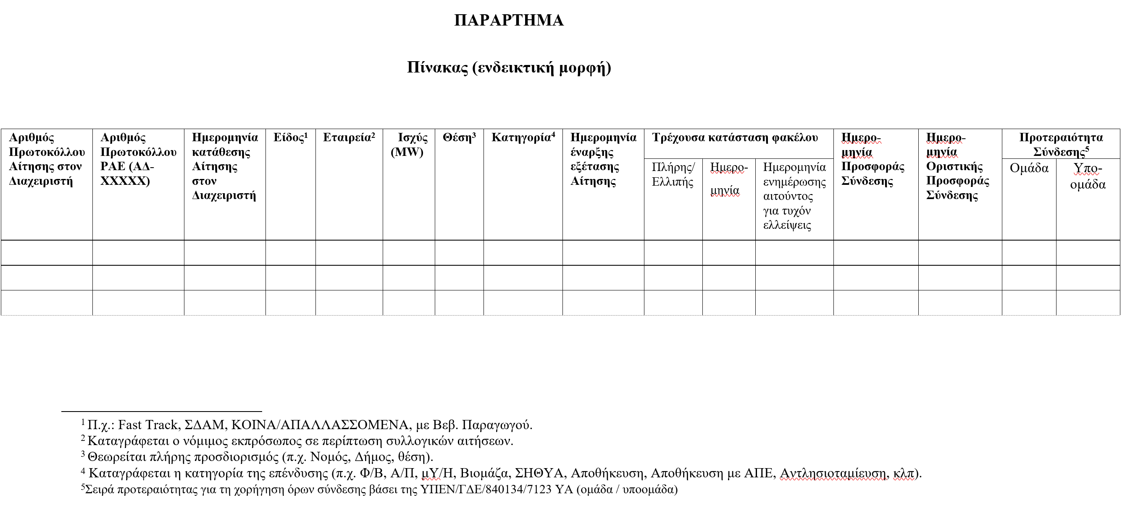
RAE Guidelines to System and Network Operators
Transparency on Grid Connection Terms – Deadline 30/09/2022
(List of applications for connection terms ought to be published by Operators in their website, using the following template by 30/09/2022.
If not published, hearing process will be initiated towards imposition of fines)

Slide 17
4
Technical Requirements for Grid and Demand Connection

Slide 18
Requirements for Grid and Demand Connection
The technology neutrality in order to trigger competition among storage technologies among various applications and scale thus enhancing innovation and reducing costs.
The revision of requirements for grid connection of generators (RfG) and on demand connection (DCC) under development.
Need for new technical requirements for storage because:
Storage units are connected to the grid through bidirectional converters, they shouldn’t be treated as single power generating units or demand facilities
Storage facility’s configuration limitations (e.g., standalone or hybrid sites) or
other specifications for synchronous or asynchronous operation when connected to the grid.

Slide 19
5
System Operation Requirements

Slide 20
Energy Availability Requirement (EAR) for FCR service
ENTSOE has expressed its wish to harmonize the duration of the EAR to either 15 min or 30 min, which has resulted in a high regulatory risk for batteries.
For a 15 min EAR, the needed battery sizing is of less than 1 hour whereas for a 30 min EAR it is closer to 1 hour and a half.
ENTSOE proposes a 30 min EAR for batteries already built, a 1.5 h battery will be necessary to provide the FCR service.
Thus, in an already installed batteries facility of 10 MW and less than one hour, the decision could lead to a 40% revenue decrease as the asset would only be able to prequalify 6 MW of FCR instead of the initial 10 MW. [The batteries designed with 15-minute discharge duration]
ACER (working closely with the NRAs) is expected to issue a decision by the end of 2022.

Slide 21
6
Funding Initiatives

Slide 22
Funding Initiative for Grid Connected Electricity Storage
The European Commission has approved the Greek state's funding initiative for 900 MW of energy storage. Under the state aid rules, € 341 million will be allocated to grid-connected electricity energy storage systems in the form of an investment grant during project construction, followed by annual support during the first ten years of operation. The funding is valued at 380,000€/MW (378,000 USD/MW). A competitive bidding process will be organized to award the project, with awarding date by the end of 2023 and projects completion by the end of 2025.
These projects will partly be funded by Greece’s portion of the EU-wide Recovery and Resilience Plan, the program to mitigate the negative economic effects of the Covid pandemic. The annual support for each project will be assessed and an adjustment will be made through a clawback mechanism if the energy storage units generate excess market revenues.
RAE has already issued RAE Decision 12/2021 (Recommendation) to Ministry of Environment and Energy on the CONE of each technology, including Storage technologies.

Slide 23
Funding Initiative for Pumped Hydro Storage in Amfilochia
The European Commission has approved, under EU State aid rules, a Greek measure to support the construction and operation of a pumped hydroelectricity storage facility in Amfilochia, Greece. The measure will be partly funded by the Recovery and Resilience Facility (‘RRF'), following the Commission's positive assessment of the Greek Recovery and Resilience Plan and its adoption by Council.
The aid will take the form of a €250 million investment grant and of an annual support – financed from a levy on electricity suppliers – to complement market revenues, in order to reach an acceptable rate of return on the investment. The supported storage facility will have a capacity of 680 Megawatts (MW) and will be directly connected to high-voltage transmission lines.

Slide 24
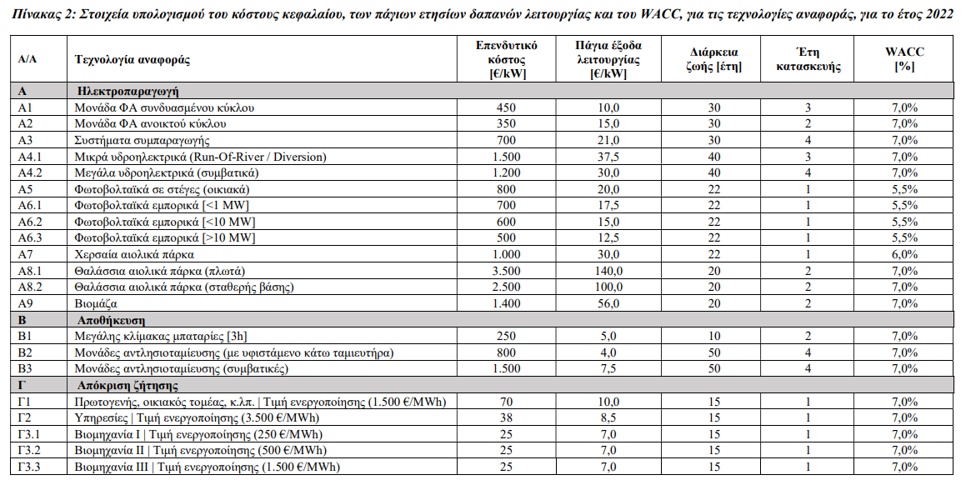
RAE Decision 12/2021:
Characteristics for each technology (CONE)

Slide 25
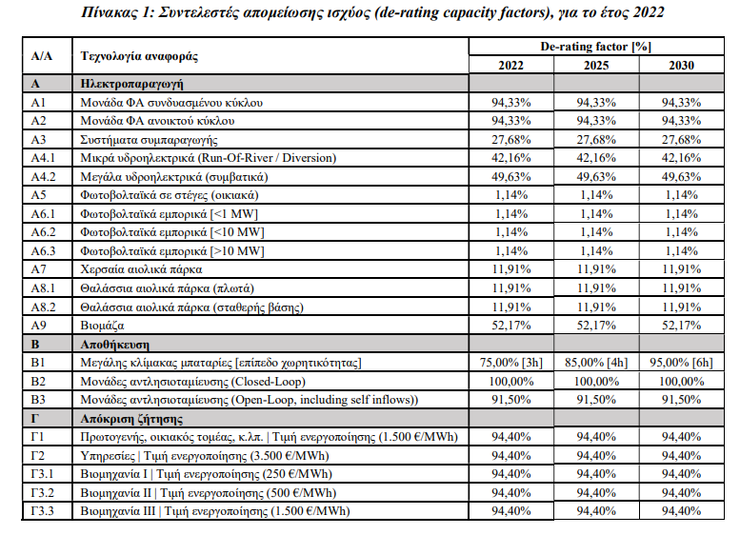
RAE Decision 12/2021:
De-rating capacity factor for each technology (%)

Slide 26
Thank you for your attention !!!
132 Pireos str., 118 54, Athens
Τel.: +30 210 3727400
E-mail: info@rae.gr

